Slide 1
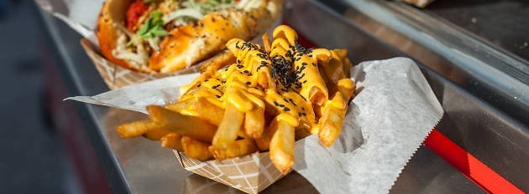
Food Truck Tinder
An App for Food Truck Foodies and Vendors
Notes:
Kathryn to

Slide 2
Elevator Pitch
Have you ever been out with friends and wondered “Where can I find a food truck near me?” and didn’t know how to find any? Well, look no further than the Food Truck Tinder app! Just open it up and any available food trucks near you can be found.
Own a food truck and don’t know how to quickly advertise your location? Food Truck Tinder is your solution! Check your truck in and your information and location will be immediately available for customers to find.
Notes:
Kathryn

Slide 3
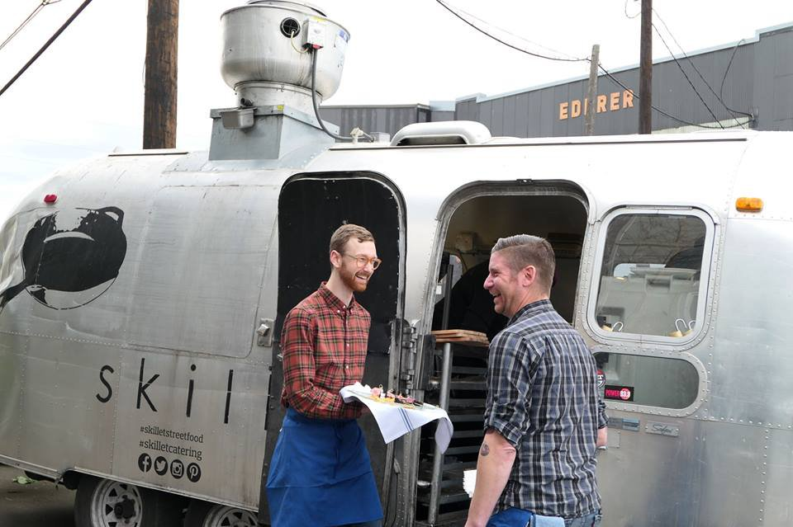
Concept
Description:
An application for the food truck enthusiast to quickly find food trucks in their vicinity.
It also allows food truck businesses to provide their location for easy locating by enthusiasts, thereby increasing foot-traffic.
One-stop shop for food trucks.
Motivation:
We wanted to increase foot traffic for food trucks after lunchtime.
Increasing visibility at night can increase revenue.
And who doesn’t love food trucks?
Notes:
Max

Slide 4
The Story
User story:
AS A food truck enthusiast,
I WANT to see where and when food trucks are available,
SO THAT I can pick a truck to eat at.
Food Truck Owner:
AS A food truck owner,
I WANT customers to know where I'm located,
SO THAT I can increase my food sales.
Notes:
Jesse

Slide 5
Process
Technologies used:
HTML
CSS
JavaScript
jQuery
Materialize
APIs
Google Maps
Tripadvisor
Firebase Realtime Database
Breakdown of tasks:
Max
Google Maps
Firebase
Kathryn
Tripadvisor
Google Maps
Jesse
Materialize
CSS
All
HTML
JavaScript
jQuery
Challenges:
Git issues!
Scoping
Global variables vs. local variables
Successes:
Git issues!
Researching
Learning new APIs
A really good MVP
Notes:
Jesse and Kathryn

Slide 6
Demo
Notes:
All

Slide 7

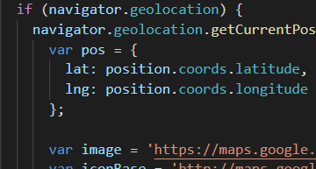


Directions for future development
For future development:
Pre-ordering to streamline order queue
Provide link to car service
E.g. UberEats, Doordash.
Menu when user clicks truck icon
Private parking spots in high foot-traffic areas to food trucks
Authentication of food trucks
Fix Tripadvisor delay when loading
Social media integration
Notes:
Any

Slide 8
Links
Deployed: https://katgrace0808.github.io/Tinder-for-Food-Trucks/
GitHub: https://github.com/katgrace0808/Tinder-for-Food-Trucks
Notes:
Any

